Slide 1



INFRARED ATMOSPHERIC SOUNDING INTERFEROMETER
OF NEW GENERATION PROGRAM:
GENERAL STATUS OVERVIEW
F.BERMUDO . IASI-NG PROJECT MANAGER for IASI-NG TEAM
CENTRE NATIONAL D’ÉTUDES SPATIALES (TOULOUSE, FRANCE)
IASI 2021 CONFÉRENCE
EVIAN, FRANCE . 06 – 10 DECEMBER 2021

Slide 2


IASI-NG CNES PROGRAM PART OF EUMETSAT POLAR SYSTEM SECOND GENERATION PROGRAM (EPS-SG)
EMBARKED ON
METOP SG-A SATELLITES SERIES DEVELOPED BY ESA
• Operational observations from polar orbit
• 2024 to 2044 timeframe
• 3 successive flight models

Slide 3




NUMERICAL
WEATHER
PREDICTION
ATMOSPHERIC CHEMISTRY
CLIMATE
MONITORING

Slide 4
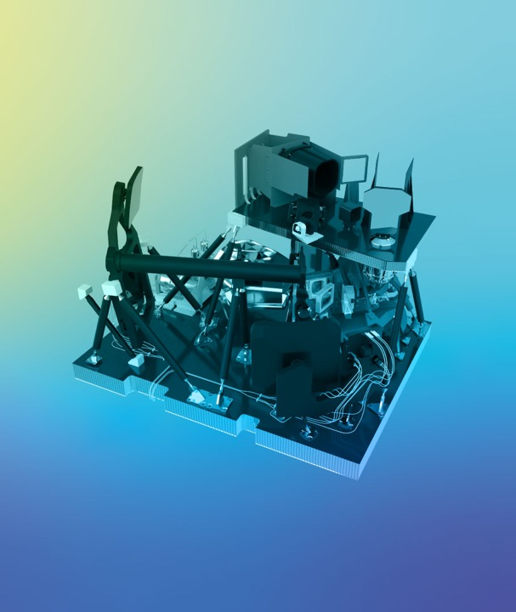


IASI-NG
PROJECT
3 instruments to be flown on the series Metop-SG A Satellites
Level 1 Operational Processor (L1CPOP) processing scientific data up to level 1C (Atmospheric Spectra)
Technical Expertise Center (IASTEC) performances monitoring in orbit

Slide 5
IASI-NG
PERFORMANCES
SPECTRAL RESOLUTION
0.25 CM⁻¹
(2 times better than IASI)
SPECTRAL RESOLUTION
0.25 CM⁻¹
(2 times better than IASI)
SPECTRAL SAMPLING
SPECTRAL SAMPLING
~17000 Spectral Channels
(2 times better than IASI)
~17000 Spectral Channels
(2 times better than IASI)
Continuity of IASI’s first generation operational observations
RADIOMETRIC
NOISE
RADIOMETRIC
NOISE
NedT ~ 0.1K
(2 times better than IASI)
NedT ~ 0.1K
(2 times better than IASI)
Improvement of some essential performances measurement
RADIOMETRIC
CALIBRATION
RADIOMETRIC
CALIBRATION
NedT ~ 0.25K
(2 times better than IASI)
NedT ~ 0.25K
(2 times better than IASI)
Allowed via a wider field of analysis
SOUNDING PIXEL SIZE DIAMETER
12 Km

Slide 6
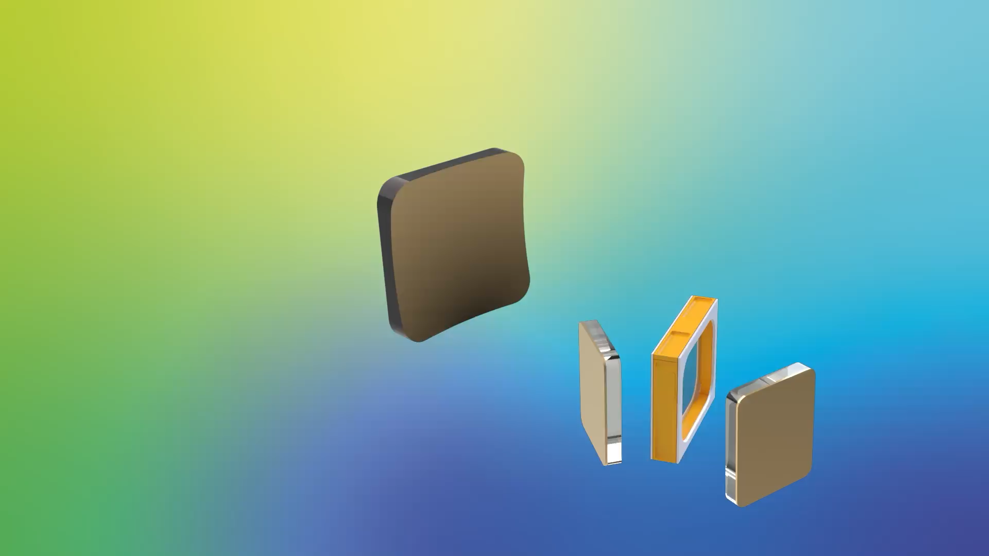
IASI-NG
INSTRUMENT CONCEPT
Interferometer: 2 beams with different optical paths (beam splitter and moving mirrors )
Different optical paths : creation of Interferogram’s by beam recombination
Interferogram’s : breakdown and spectral analysis

Slide 7
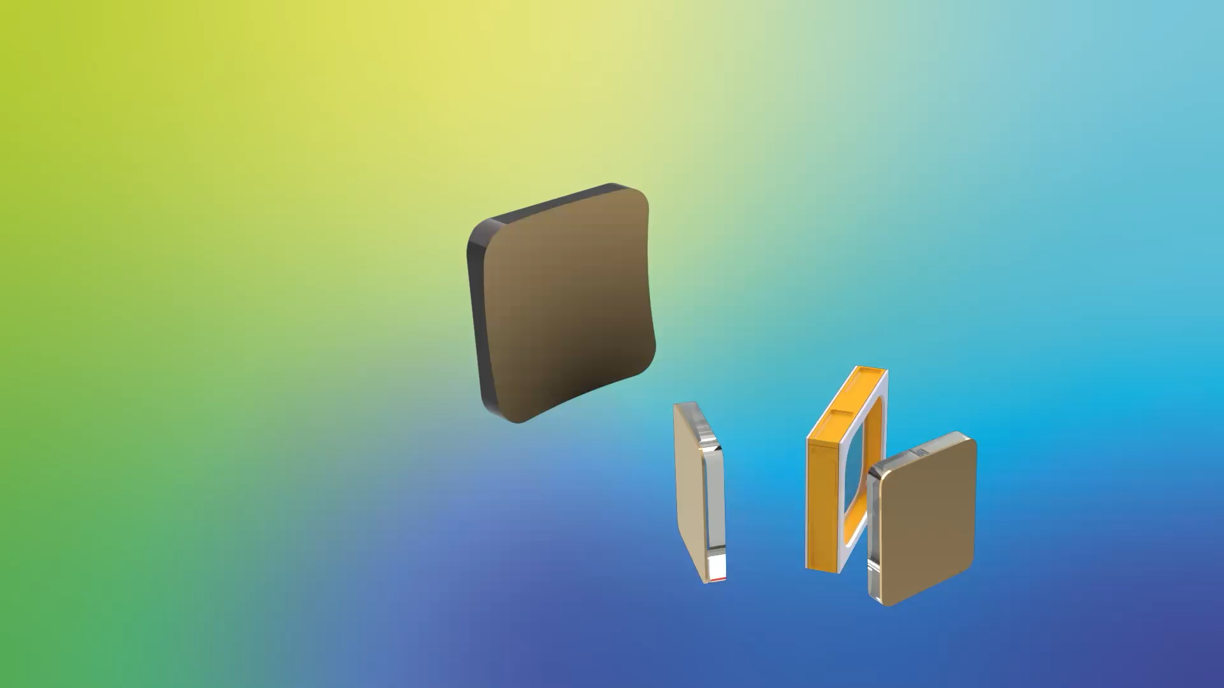
IASI-NG
INTRUMENT CONCEPT
Off the axis: field effects appear (rings of parasitic interference) affecting measurement quality
Compensating for the field effects is essential

Slide 8

IASI-NG
INSTRUMENT CONCEPT
Field effects compensation: inserting dynamically glass of varying thickness
Synchronization between optical path difference and variation in glass thickness
Achieved through 2 pairs of prisms, synchronized via an unique device movement

Slide 9
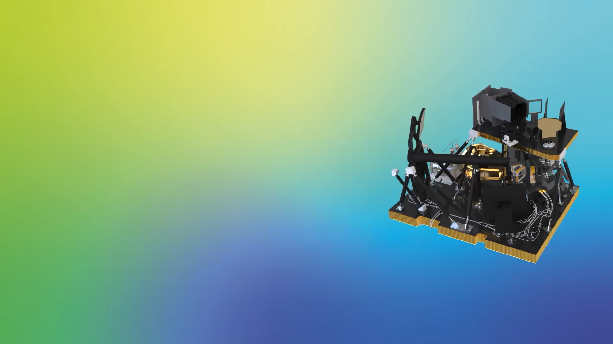
IASI-NG
INSTRUMENT CONCEPT
Performances improvement allowed by innovative instrumental concept proposed by Airbus Defense and Space
First implementation in space of a Mertz Interferometer

Slide 10
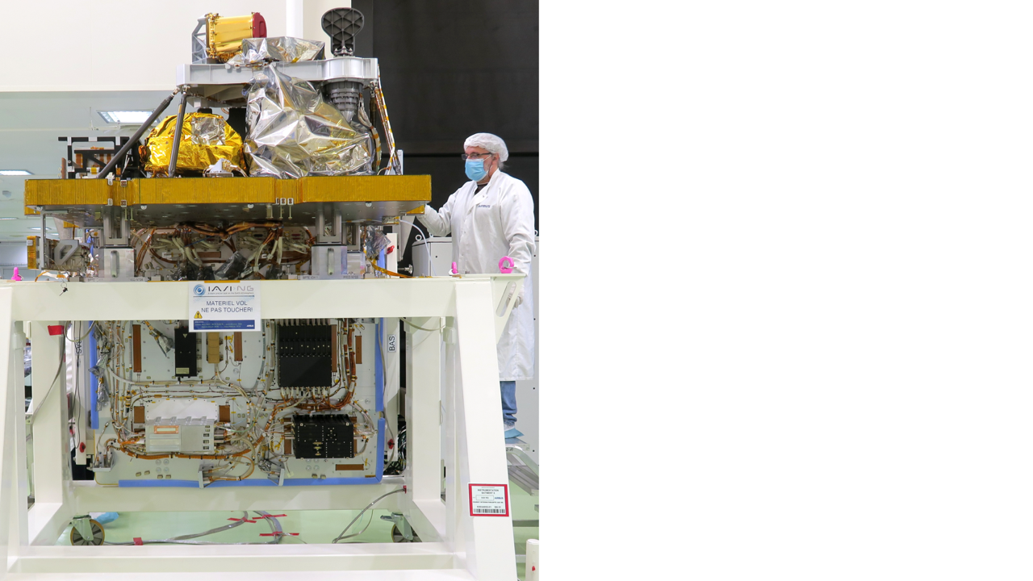
IASI-NG
DEVELOPMENT STATUS:
MAIN MILESTONES ACHIEVED
Consolidation of instrument definition with completion of Instrument Critical Design review (Early 2020)
Completion of Engineering model test campaign in 2021
Proto Flight Model integration started

Slide 11

IASI-NG
DEVELOPMENT STATUS:
MAIN MILESTONES ACHIEVED
Consolidation of System definition with completion of On-ground algorithm processing:
To correct the imperfection of the instrument : calibration of the data, spectrally and radiometrically
Equalization of the provided spectra with an unique Spectral Response Function, for all channels and all pixels
Geo-localize the sounder pixels and information about the scene description inside the pixel Field Of View (radiance classification)

Slide 12
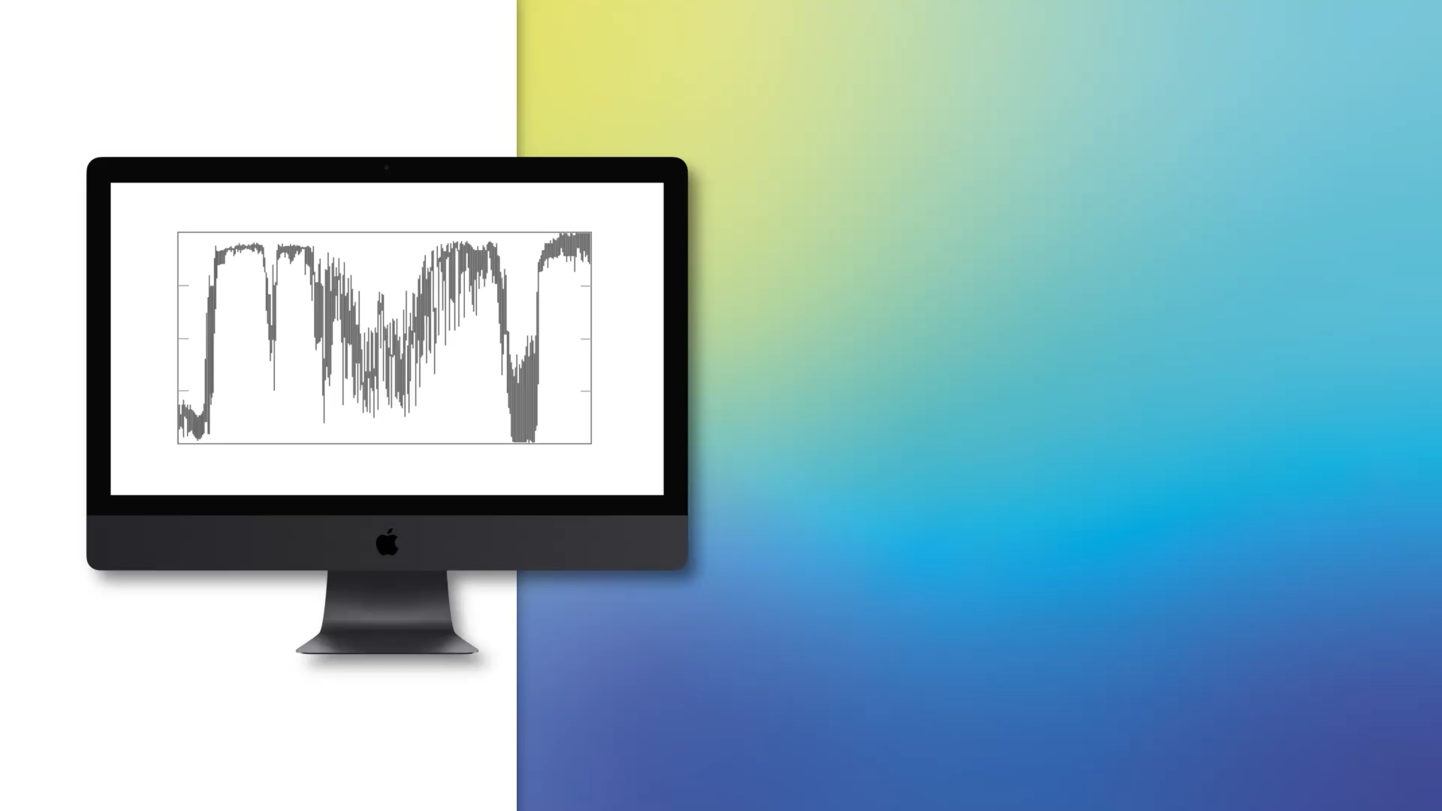
IASI-NG
DEVELOPMENT STATUS:
MAIN MILESTONES ACHIEVED
Consolidation of System definition with completion of On-ground algorithm processing:
Calibration of the data, spectrally and radiometrically
Equalization of the provided spectra with an unique Spectral Response Function, for all channels and all pixels
First Mission performances assessment achieved with success of System Critical Design review (Mid 2020)

Slide 13
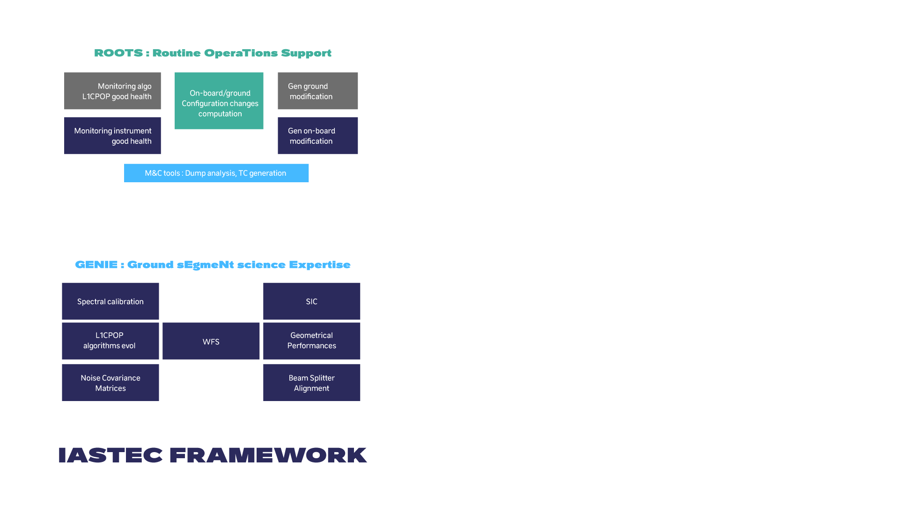
IASI-NG
DEVELOPMENT STATUS:
MAIN MILESTONES ACHIEVED
Consolidation of System definition with IASTEC requirements and functional breakdown:
ROOTS functions
  Instrument and L1C processing monitoring (quality flags , parameter trend)
  Generation of new OB/OG SW updates parameters
  Visualization tool
  Routine processing chains
GENIE functions : expertise function tool for fine performances estimation and investigation

Slide 14




IASI-NG
DEVELOPMENT STATUS:
MAIN MILESTONES COMING SOON
Completion of Proto Flight Model integration :
COMPLETED !!!
CBB
Exhaustive Qualification and test campaign with performances test under Vacuum early 2022
CBB FPI
WBB
CBB CAG
WBB

Slide 15

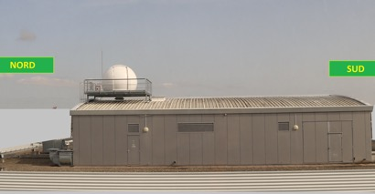
IASI-NG
DEVELOPMENT STATUS:
MAIN MILESTONES COMING SOON
Completion of Proto Flight Model integration and test campaign with performances test under Vacuum early 2022
Sun acquisition with comparison with Compact High-Spectral-Resolution Infrared Spectrometer (CHRIS) acquisition

Slide 16
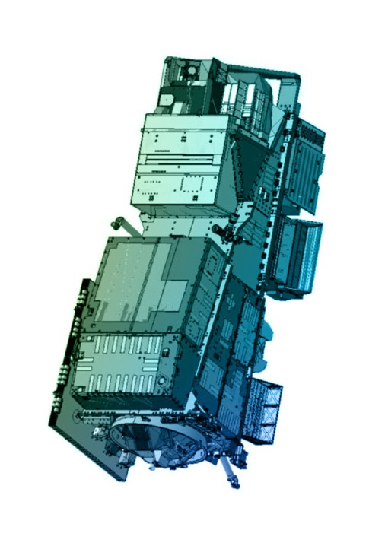

IASI-NG
DEVELOPMENT STATUS:
MAIN MILESTONES COMING SOON
Completion of Proto Flight Model integration and test campaign with performances test under Vacuum early 2022
Integration and test campaign of IASI-NG instrument on Metop SG A satellite in 2022-2023

Slide 17
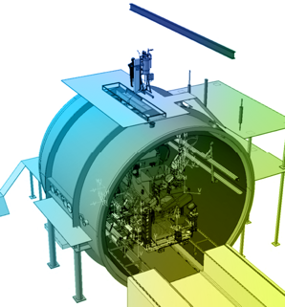
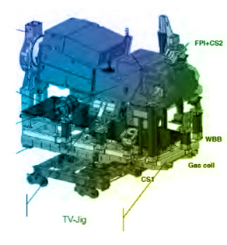
IASI-NG
DEVELOPMENT STATUS:
MAIN MILESTONES COMING SOON
Completion of Proto Flight Model integration and test campaign with performances test under Vacuum early 2022
Integration and test campaign of IASI-NG instrument on Metop SG A satellite in 2022-2023
Performances checked during Satellite Thermal Vacuum in 2022

Slide 18

IASI-NG
DEVELOPMENT STATUS:
MAIN MILESTONES COMING SOON
Integration and test of the Version 1 (Partial Processing) Level 1C processor in the EUMETSAT Payload Processing Center in 2022
Integration and test of the Version 2 (Full processing) of the Level 1C processor in the EUMETSAT Payload Processing Center in 2023
Completion of development and Operational Qualification of Technical Expertise Center in 2023

Slide 19
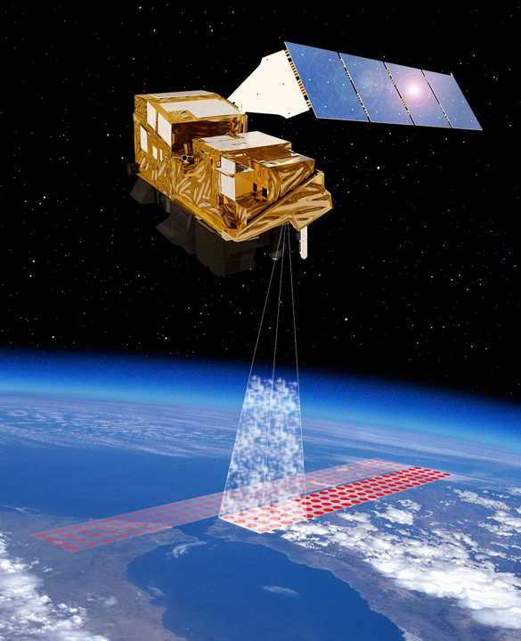
IASI-NG
DEVELOPMENT STATUS:
MAIN MILESTONES COMING SOON
Integration and test of the Level 1C processor in the EUMETSAT Payload Data Acquisition and Processing center and Operational qualification of Technical Expertise Center in 2023
Launch campaign and launch from Guyana Space Center in 2024
In Orbit Verification phase (3 months ) and Cal/Val phase ( 6 months)

Slide 20



Slide 21
THANK YOU FOR YOUR ATTENTION !

